Slide 1






Transform, engage, empower
Avanade
Digital Employee Experience
Work will never be the same
Digital transformation drives opportunities, as well as challenges. Companies who engage their workforce with a modern digital workplace will meet those challenges head on.
78%
See improved productivity and innovation
82%
See improved employee satisfaction
70%
See increased revenue
Source: Vanson Bourne Research
Transformation at the right pace
SHORT TERM
LONG TERM
Business
processes
Most common processes at employees’ fingertips
Digital agents complete routine tasks
Behaviors
Leverage and share skills,
experience and knowledge
Bots and personal assistants automate tasks and better serve customers
Information
Relevant information is easy to access securely
Relevant information delivered automatically as needed
Conversation
Work seamlessly and securely with colleagues, customers and suppliers
Employee queries answered automatically and contextually
Devices
Workplace is available anywhere on any device
Smart devices and sensors deliver information and recommend actions

Slide 2


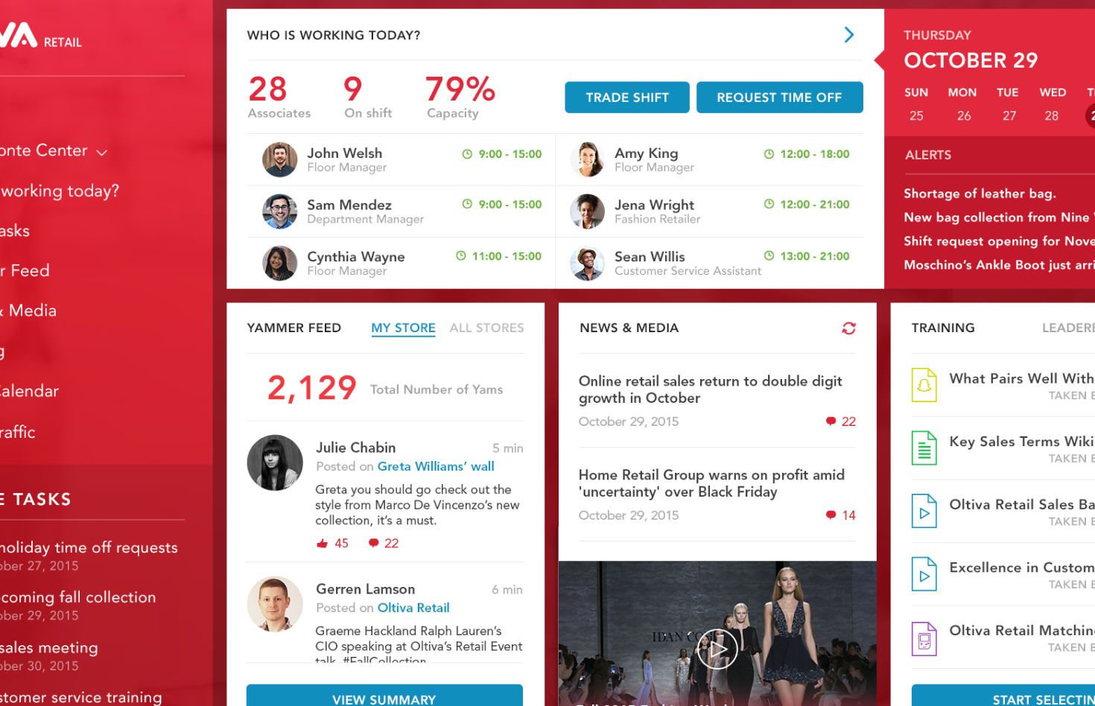
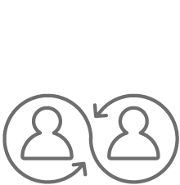
We understand your path to a digital workplace
Our exclusive iDays workshops include strategy development, a maturity model, and readiness assessments to generate your digital roadmap
Our groundbreaking Digital Workplace Insights diagnostics tool establishes your baseline, assesses progress, and measures value
Change enablement methodology provides stakeholder analysis, a business impact assessment, engagement activities, and more
Proprietary accelerators and tools help you work faster and smarter
Backed by analytical insights, a more engaging experience puts the most productive content and tools at your employee’s fingertips
Work with a strategic,
long-term partner
Contact us
Let us set up a Digital Workplace Innovation Day to review success stories and demos and experience Avanade’s Digital Roadmap methodology.
<insert contact name>
<insert contact email>
Avanade can help you continuously identify and execute short- and long-term strategic change, for specific workforces or your entire company

